Slide 1
BLOOD DONATION MANAGEMENT SYSTEM
N.R.VIVEKA
2021IT45
Under the Guidance of
Mrs.P.Alagumeena, MCA.,M.Phil.,PGDC

Slide 2
PROJECT INTRODUCTION
Blood donation management system enhance the process of collecting, storing and distributing blood
Blood donation management system is designed to be used by blood banks
It is an online system through which users can register their details to donate and receive blood according to their specification such as blood group
This project aims to address the critical need for an efficient and organized system in the healthcare sector, ensuring that a sufficient and safe blood supply is readily available to meet the demands of the patients

Slide 3
ABSTRACT
Blood donation management system tracks the availability of blood in the blood bank
It stores information about people who donate blood(like their details and health history) and people who need blood(like their details and what blood group needed)
When a hospital or clinic need blood for a patient, this system finds the right blood quickly and makes sure it gets to the hospital fast
It makes easier for the people who work at the blood bank
It is used to store, process, retrieve,analyze information concerned with the administrative and inventory management within the blood bank

Slide 4
FRONT END AND BACK END
FRONT END:
Html
CSS
BACK END:
Python with MySQL

Slide 5
MODULES
Blood bank Login
User Login
Blood Inventory
Donor Registration
Receiver Registration
Donate Request
Receive Request

Slide 6
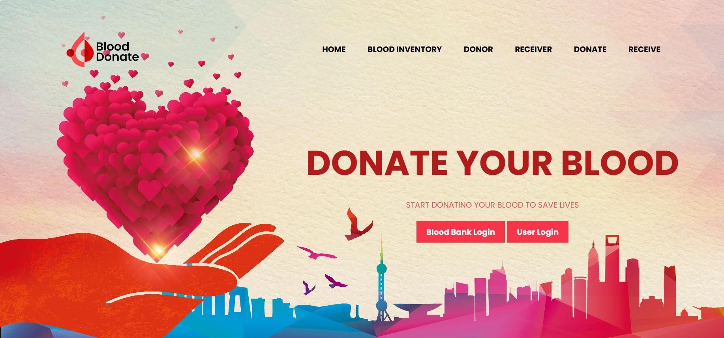
HOME:

Slide 7
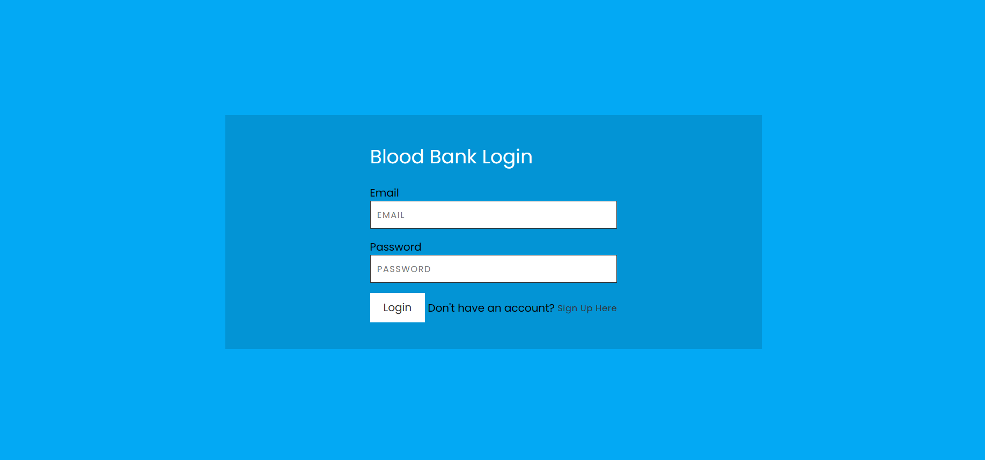
BLOOD BANK LOGIN:

Slide 8
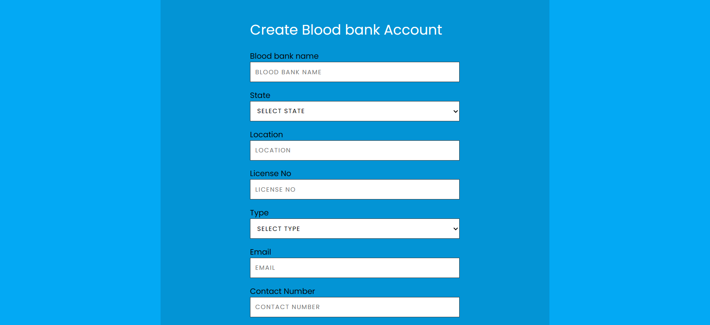

REGISTER:

Slide 9
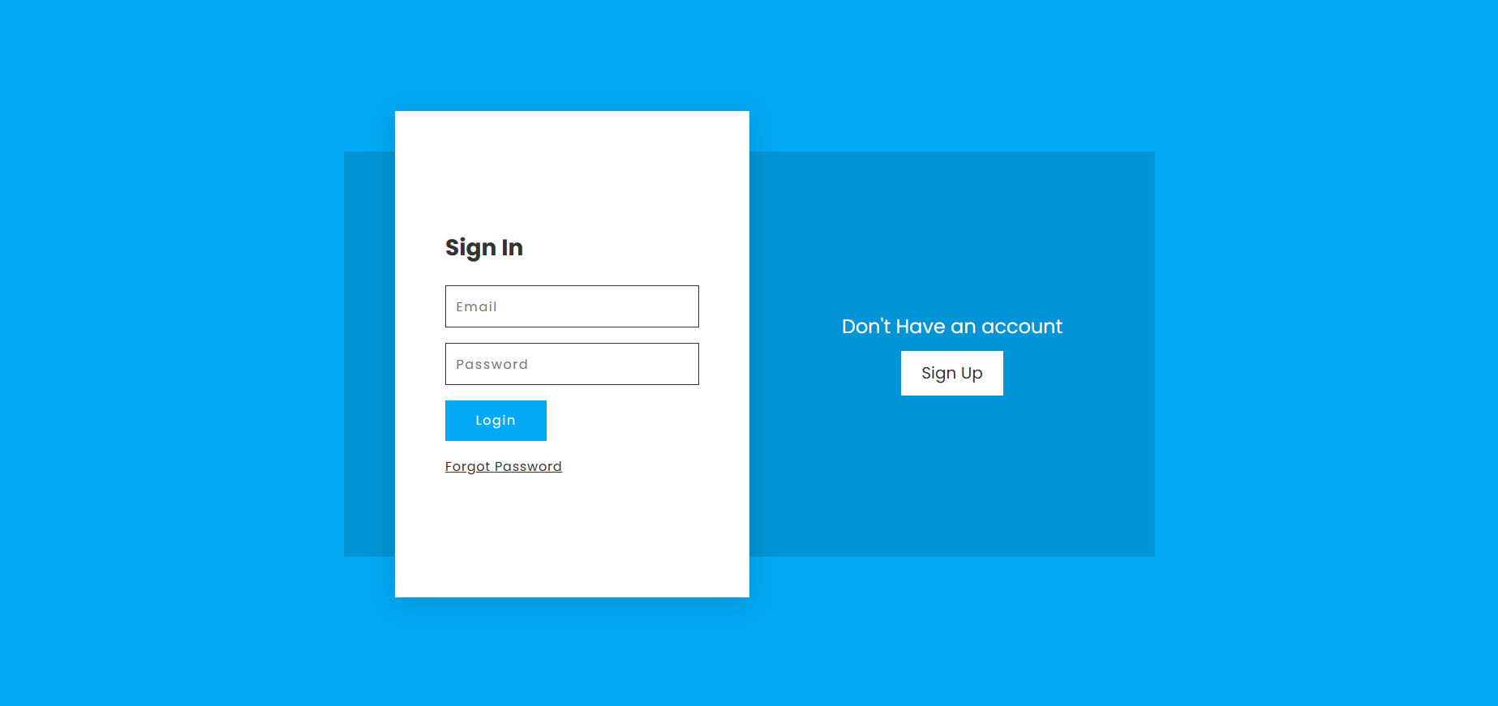
USER LOGIN:

Slide 10
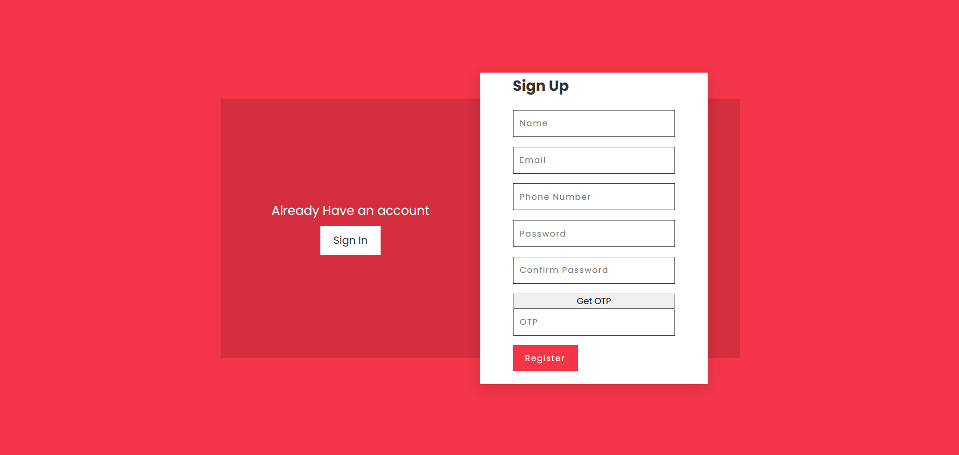
REGISTER:

Slide 11
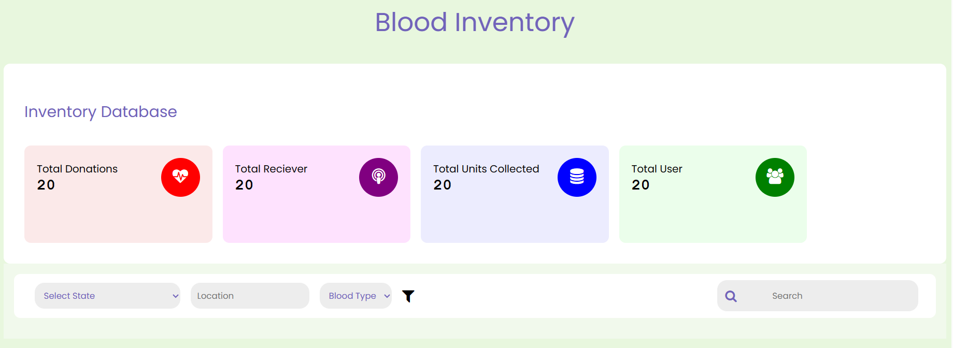
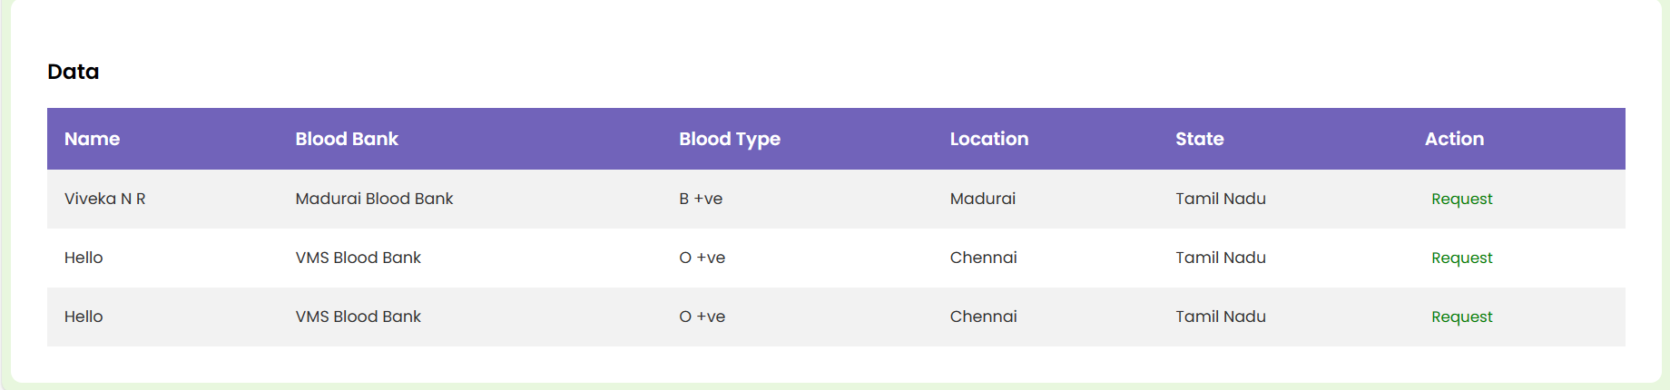
BLOOD INVENTORY:

Slide 12
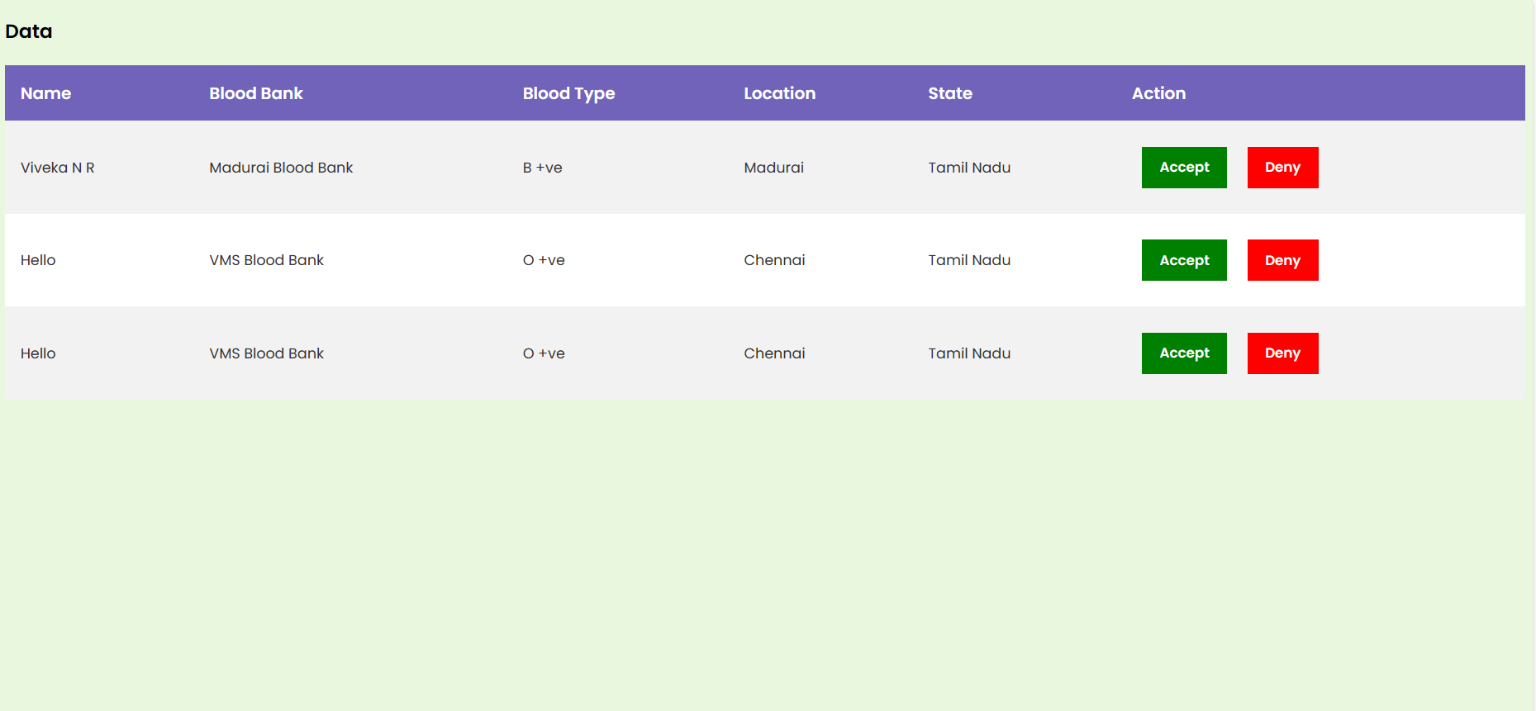
DONOR REGISTRATION:

Slide 13
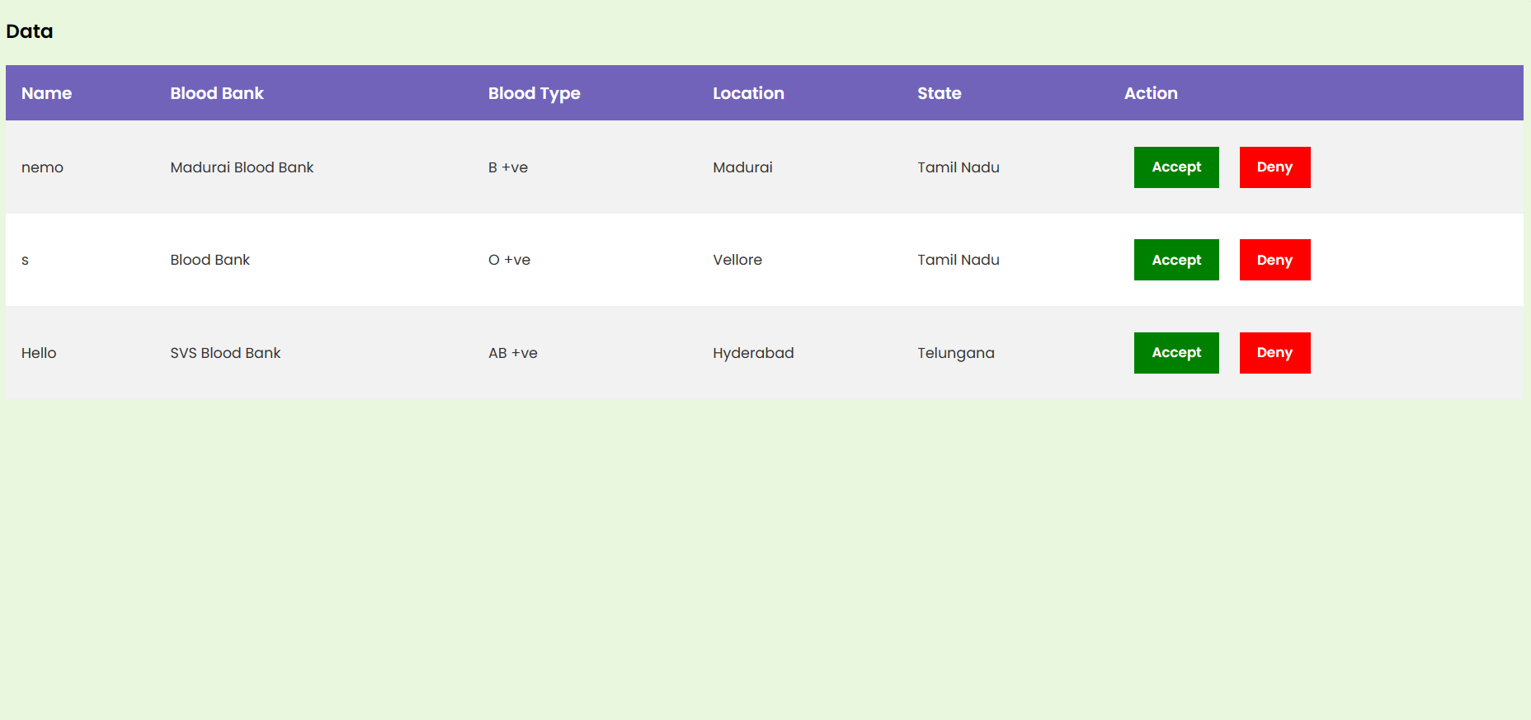
RECEIVER REGISTRATION:

Slide 14
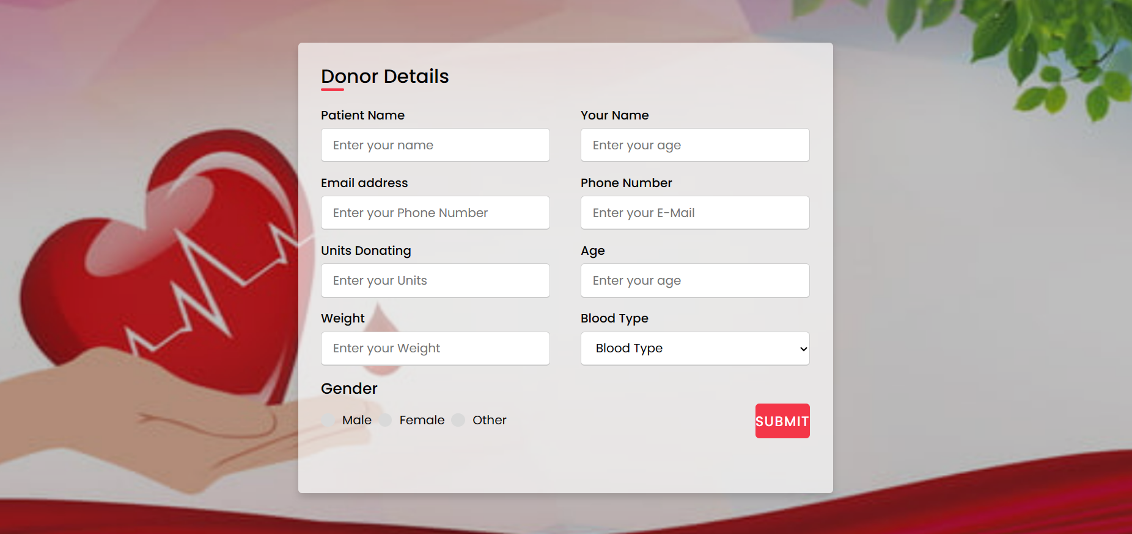
DONOR REQUEST:

Slide 15
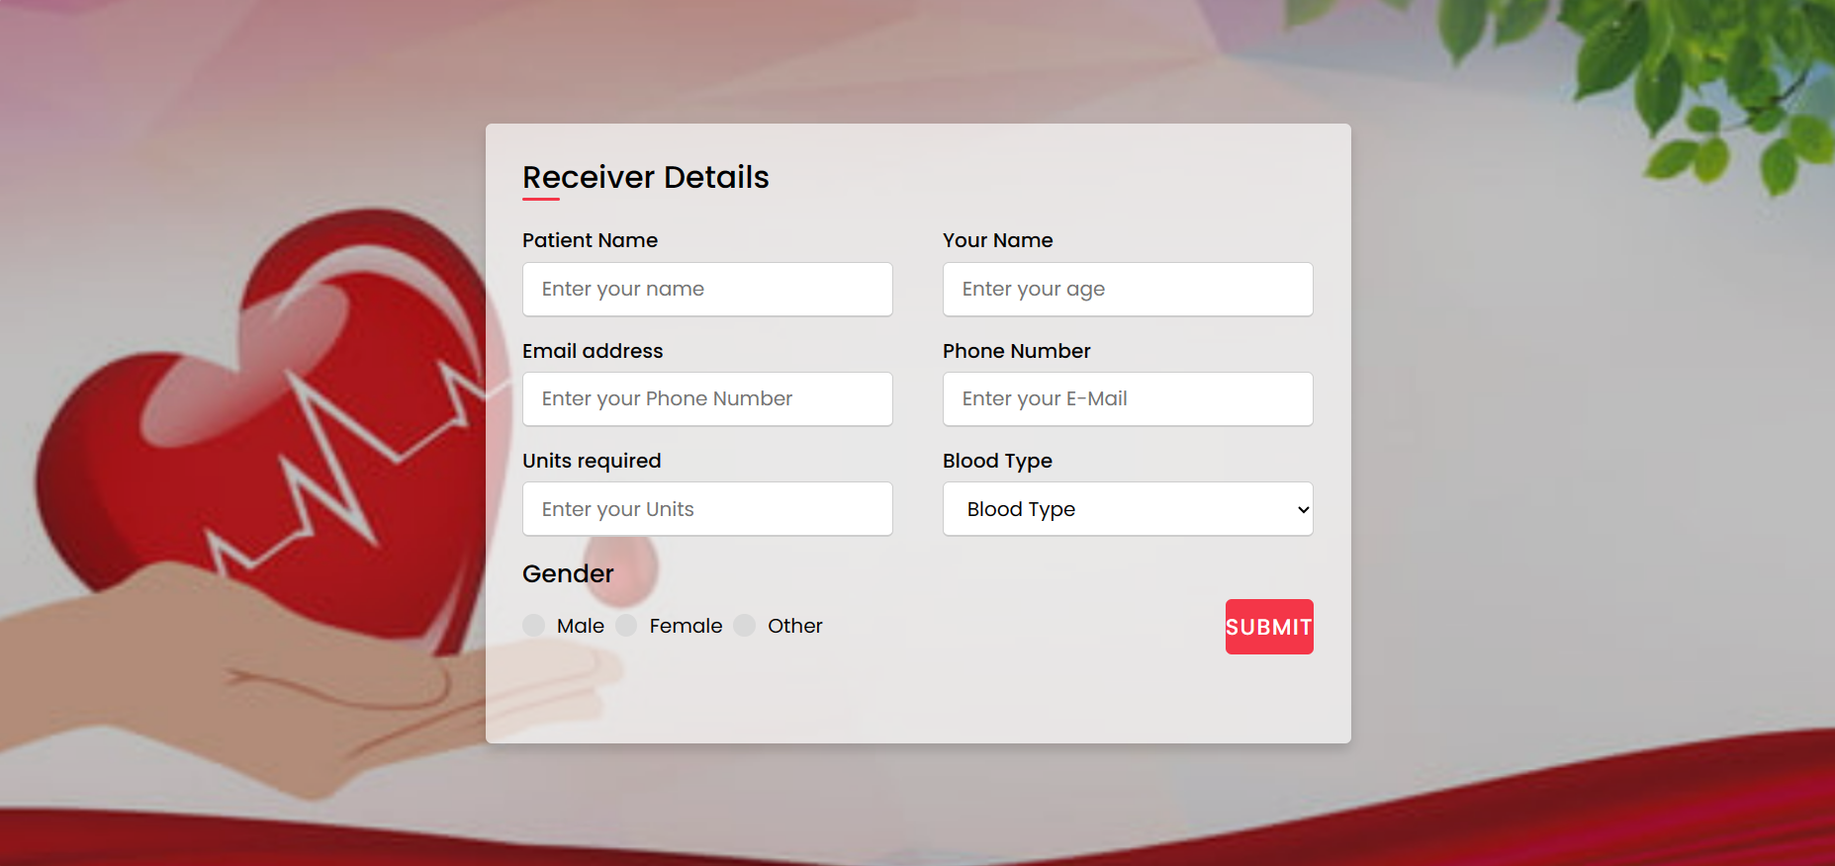
RECEIVER REQUEST:

Slide 16
CONCLUDE:
The system has enabled hospitals and blood banks to maintain up-to-date records of their blood inventory, ensuring that blood is available when needed
By providing an online platform, we have encouraged more individuals to participate in the noble act on blood donation
This project makes a positive difference in healthcare and the lives of countless individuals

